Slide 1
Database Objects

Slide 2
Agenda
SQL server Data types
SQL Server Database Types
SQL Ranked Functions

Slide 3
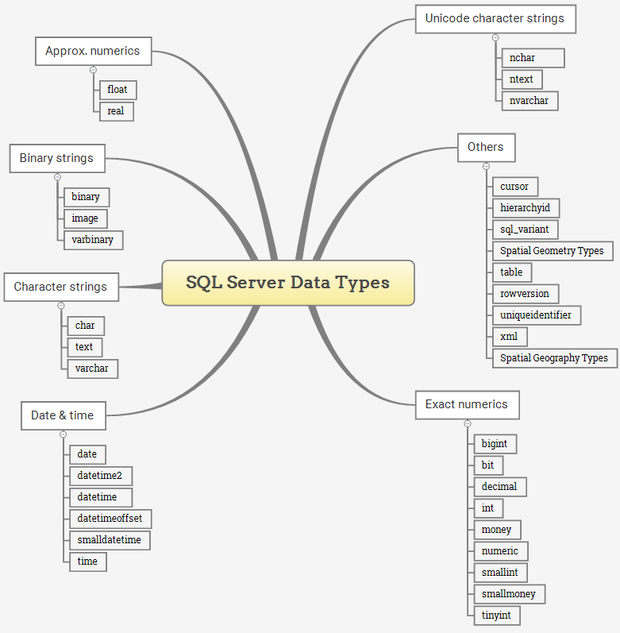

Slide 4
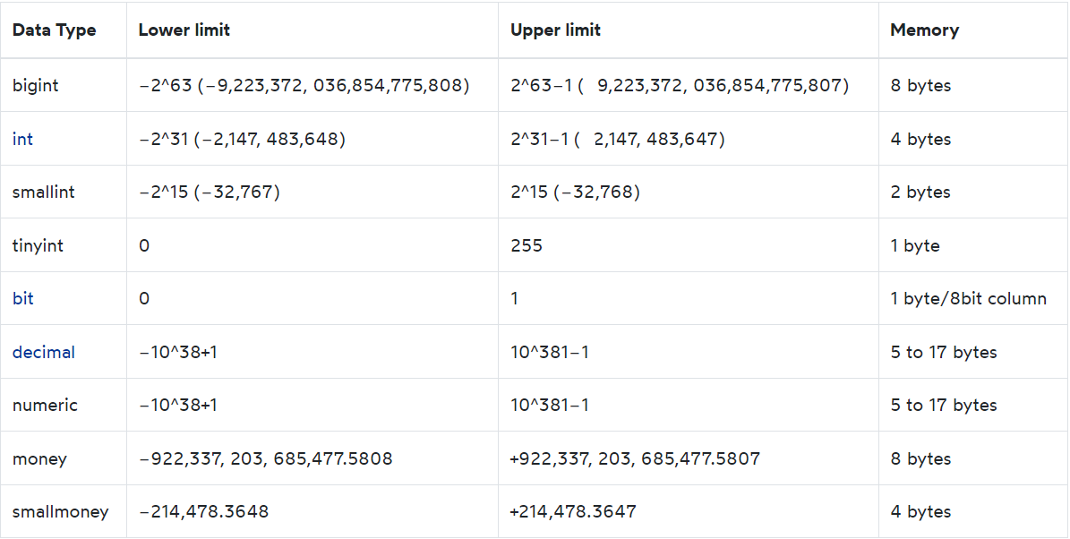
Exact numeric data types
Notes:
Notice that SQL Server will remove ntext, text, and image data types in its future version. Therefore, you should avoid using these data types and use nvarchar(max), varchar(max), and varbinary(max) data types instead.

Slide 5
Approximate numeric data types
Real (4 byte ) max floating point 7
Float (8 bytes)

Slide 6
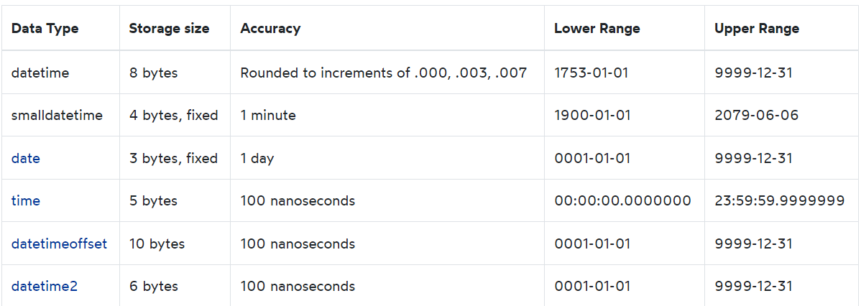
Date & Time data types
If you develop a new application, you should use the time, date , datetime2 and datetimeoffset data types. Because these types align with the SQL Standard and more portable.
In addition, the time, datetime2 and datetimeoffset have more seconds precision and datetimeoffset supports time zone.

Slide 7
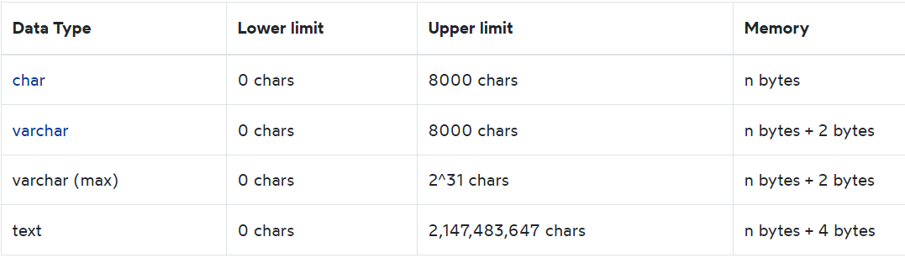
Character strings data types
Character strings data types allow you to store either fixed-length (char) or variable-length data (varchar). The text data type can store non-Unicode data in the code page of the server.

Slide 8
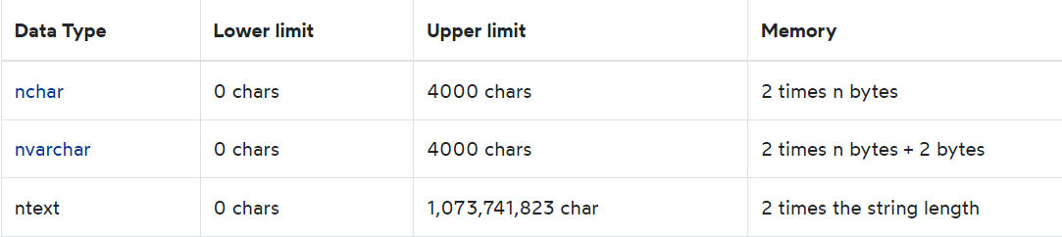
Unicode character string data types
Unicode character string data types store either fixed-length (nchar) or variable-length (nvarchar) Unicode character data.

Slide 9
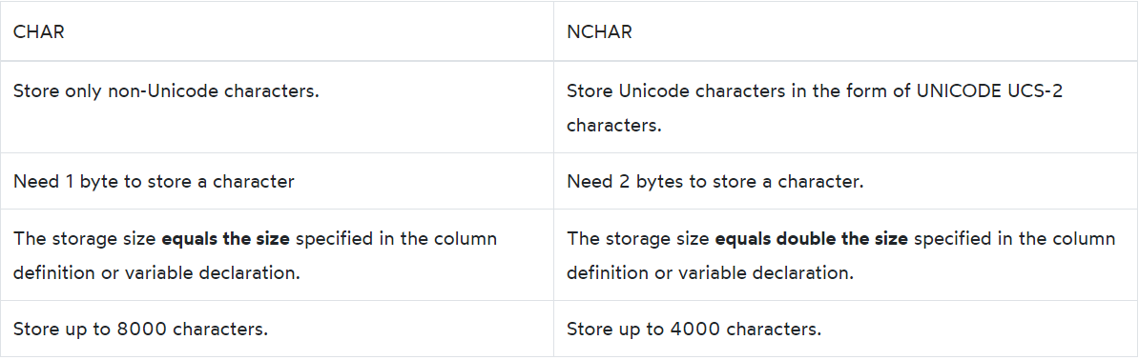
CHAR vs. NCHAR

Slide 10
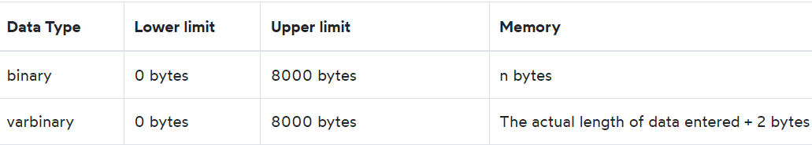
Binary string data types

Slide 11
Practical Example
On Bikestore DB Create new Supplier Table , which include the following columns
Suplier_First name
Suplier_last_name
Phone
Address
Company name
note: many company may have an Arabic company name

Slide 12
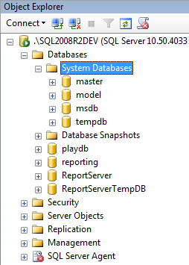
SQL Server database types
System databases
Snapshots database
Reporting database
Sample database
User defined database

Slide 13
SQL Server database / System DB
The master system database stores system-level information of the SQL server instance.
The msdb database is used by SQL Server Agent for jobs & alerts.
The model database is served as a template for creating other databases.
The tempdb system database stores the temporary objects and is recreated every time the SQL Server starts.

Slide 14
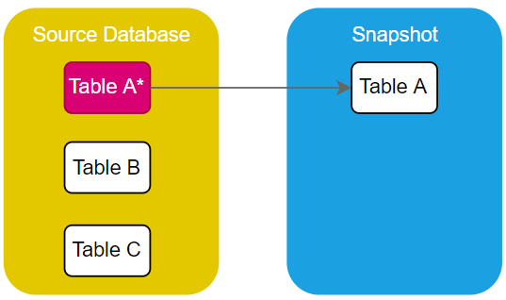
SQL Server database/Snapshot
A database snapshot is a read-only, static view of a database in an SQL Server instance.
However, when you modify the source database, SQL Server copies the changes to the snapshot. In other words, the size of the snapshot grows as you make changes to the source database:
A database can have multiple snapshots that persist until you explicitly drop them.

Slide 15
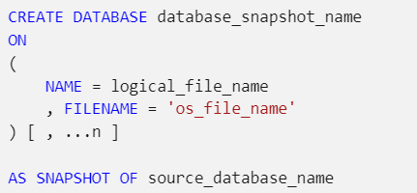
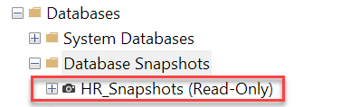
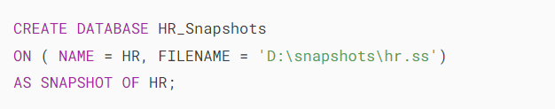
SQL Server database/Snapshot
CREATE DATABASE ... AS SNAPSHOT to create a snapshot of the HR database:
Note that the D:\snapshots folder must exist so that the above command can execute successfully.

Slide 16
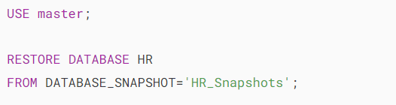
SQL Server database/Snapshot
restore the HR database from the HR_Snapshots database:

Slide 17
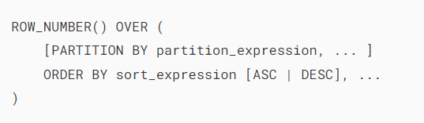
SQL Server RANK Function
ROW_NUMBER()
The PARTITION BY clause divides the result set into partitions.
The ROW_NUMBER() function is applied to each partition separately and reinitialized the row number for each partition.
The PARTITION BY clause is optional.
The ORDER BY clause defines the logical order of the rows within each partition of the result set. The ORDER BY clause is mandatory because the ROW_NUMBER() function is order sensitive.

Slide 18
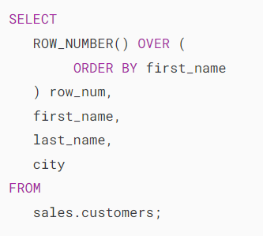
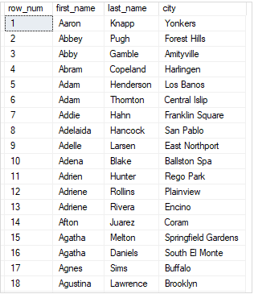
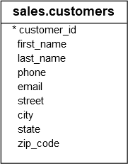
SQL RANK Function / row_number ()
In this example, we skipped the PARTITION BY clause, therefore, the ROW_NUMBER() treated the whole result set as a single partition.

Slide 19
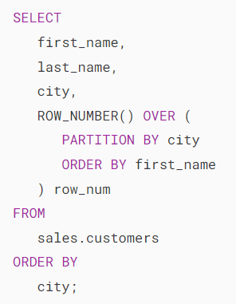
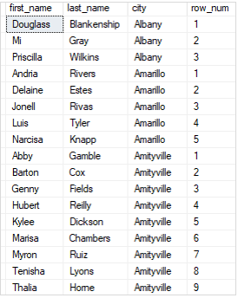
SQL RANK Function / row_number ()
In this example, we used the PARTITION BY clause to divide the customers into partitions by city. The row number was reinitialized when the city changed.

Slide 20
SQL RANK Function/ RANK()
2. Rank () Function
The rows within a partition that have the same values will receive the same rank. The rank of the first row within a partition is one.
The RANK() function adds the number of tied rows to the tied rank to calculate the rank of the next row, therefore, the ranks may not be consecutive.
The RANK() function is useful for top-N and bottom-N reports

Slide 21
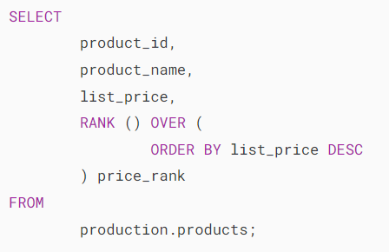
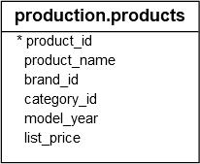
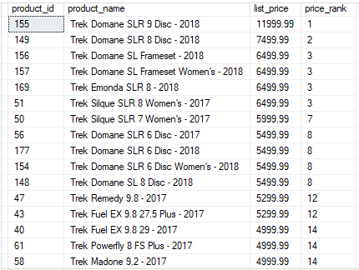
SQL RANK Function/ RANK()

Slide 22
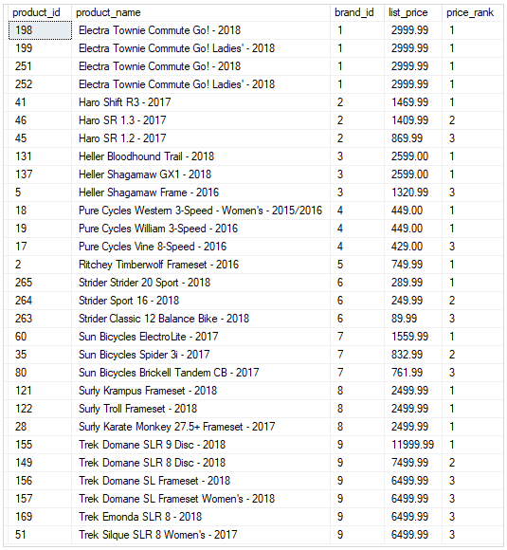
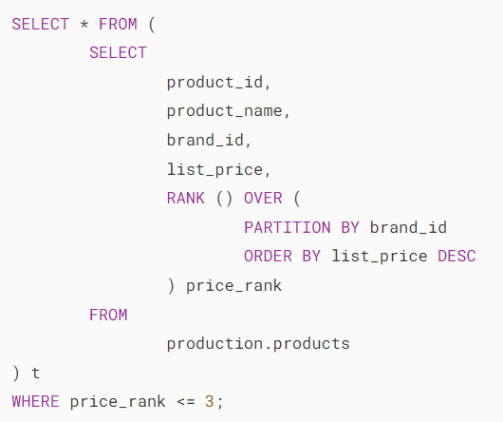
SQL RANK Function/ RANK()

Slide 23
SQL RANK Function/ dense_RANK()
3. dense_RANK() Function
DENSE_RANK() function doesn’t leave a gap;

Slide 24
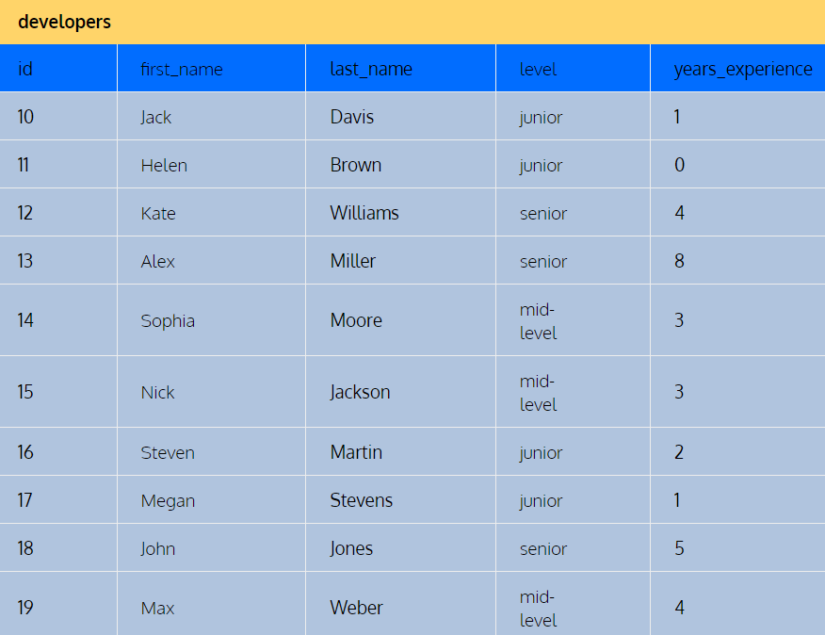
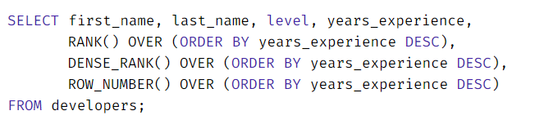
Exercise for Ranked Function

Slide 25
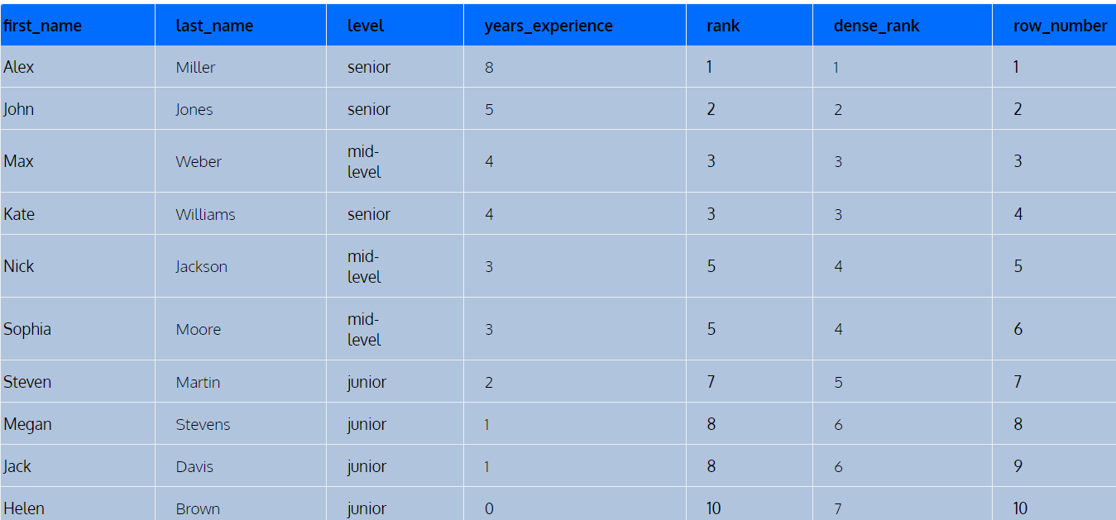
Solution

Slide 26
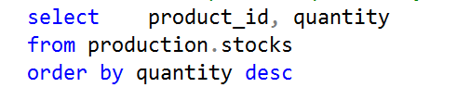
Practical Example
List all product quantity in the Bickstore stock, sort the result by large quantity

Slide 27
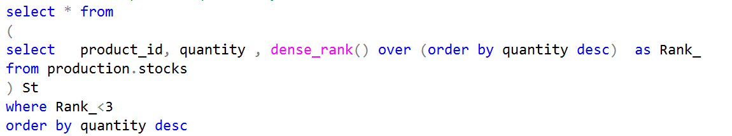
Practical Example
Retrieve 2 different product quantity in the Bickstore stock

Slide 28
Thanks
☺

